Slide 1
A Long Way Gone
Gallery Walk

Slide 2
1

Slide 3
2

Slide 4
3

Slide 5
4

Slide 6
5

Slide 7
6

Slide 8
7

Slide 9
8

Slide 10
9

Slide 11
10

Slide 12
11

Slide 13
12

Slide 14
13

Slide 15
14

Slide 16
15

Slide 17
16

Slide 18
17

Slide 19
18

Slide 20
19

Slide 21
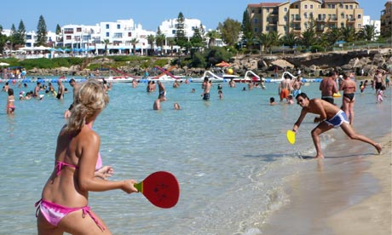
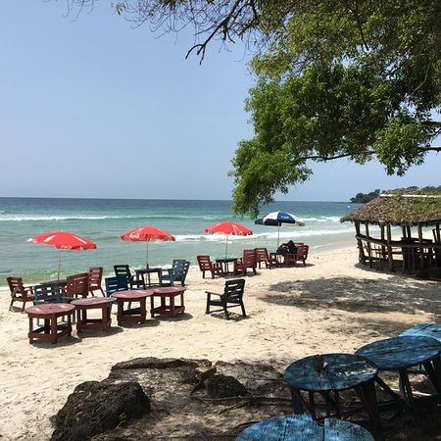
20

